Slide 1
Caching with Redis on Azure
Brian Hall
Chief minion @ Nebbia Technology

Slide 2


Me
Chief Minion @ Nebbia Technology
Twitter: @Hallmanac
Github: https://github.com/hallmanac
Github: https://github.com/Nebbia/RedisRepo
Github: https://github.com/Hallmanac/redis-aspnet-azure
Email: Brian@NebbiaTech.com

Slide 3
Goals for this talk
Basic overview of Redis
Approaches to using it as a Cache
Azure Features

Slide 4
Interruptions welcome
Ask Questions
I’ll start

Slide 5



Slide 6






Cross platform, In-Memory, Key Value Store

Slide 7

It has Data Types other than strings
…unless people are the data

Slide 8

…with Operations for manipulating that data

Slide 9
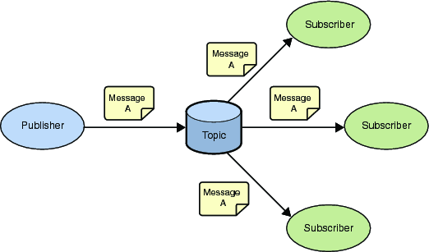
It’s a Pub/Sub system as well

Slide 10
Redis Keys
Binary safe strings
Case Sensitive
Max 512MB
Don’t do it!
Hash the key instead

Slide 11
Redis Types
String
List
Set
Sorted set
Hash

Slide 12
Redis Type: String
Binary safe

Slide 13
Redis Type: List
Collection of Non-unique strings
Setup like a Linked list
Push and pop is cheap
Small lists as fast as very large lists
Seek by index is expensive (a.k.a. random access)

Slide 14
Redis Type: Set
Unordered collection of strings
Random Access is fully supported
Additional operations like intersect and union

Slide 15
Redis Type: Sorted Set
Like a set but with ordering via a "floating point value" called a score
Score is based on how the elements are added/updated
Sort operation is done at time of writing to the Redis DB, based on the score value (not when reading)
Sorted by score and then lexigraphically
Example:
Key: “UserBirthdays”
Value:
{ “UserId”: “5”, “Username”: “Esteban”}
Score: 635787405990736030
DateTimeOffset.UtcNow.Ticks

Slide 16
Redis Type: Hash
Collection of name/value pairs
A single hash holds as much as you have memory available
A “Cache within a Cache”

Slide 17

But Why Redis?

Slide 18

Decouples app cache from app server
Redis Server
Web Server 1
API Server
Web Server 2

Slide 19
Survives App or API server recycle
Redis Server
Web Server 1
API Server
Web Server 2

Slide 20
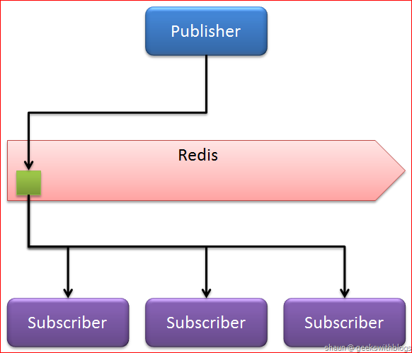
Can be used as Pub/Sub

Slide 21
Redis Cache Storage Strategies
Single cache key per object stored in a Redis string as JSON
Single cache key per object stored in a Redis hash
Multiple objects stored in a single Redis hash
Where the hash field (a.k.a. key) is the object’s ID
And the hash value is the object stored as JSON

Slide 22
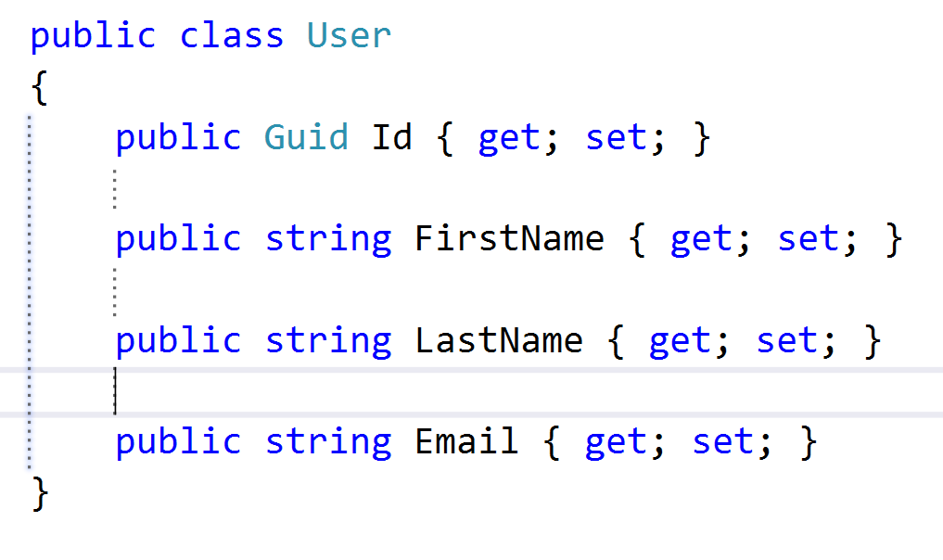
Object as a Redis String
Redis Key
user:0410a5cf-5cfe-40df-9524-81f05db76c33
Redis String Value
{
“Id”: 0410a5cf-5cfe-40df-9524-81f05db76c33,
“FirstName”: “Brian”,
“LastName”: “Hall”,
“Email”: “Brian@NebbiaTech.com”
}

Slide 23
Object as a Redis Hash
Redis Key
user:0410a5cf-5cfe-40df-9524-81f05db76c33
Redis Hash Value
Field - “Id” Value - “0410a5cf-5cfe-40df-9524-81f05db76c33”
Field - “FirstName” Value - “Brian”
Field - “LastName” Value - “Hall”
Field - “Email” Value - “Brian@NebbiaTech.com”

Slide 24
Collection of Object types as a Redis Hash
Redis Key
some-namespace:user
Redis Hash Field
“0410a5cf-5cfe-40df-9524-81f05db76c33”
Redis Hash Value
{
“Id”: 0410a5cf-5cfe-40df-9524-81f05db76c33,
“FirstName”: “Brian”,
“LastName”: “Hall”,
“Email”: “Brian@NebbiaTech.com”
}

Slide 25
Collection of Object types as a Redis Hash
Redis Key
some-namespace:users
Redis Hash Field
“0410a5cf-5cfe-40df-9524-81f05db76c33”
Redis Hash Value
{
“Id”: “0410a5cf-5cfe-40df-9524-81f05db76c33”,
“FirstName”: “Brian”,
“LastName”: “Hall”,
“Email”: “Brian@NebbiaTech.com”
}
Redis Hash Field
“f89708a8-b10e-4396-81a5-e18fa39ecec2”
Redis Hash Value
{
“Id”: “f89708a8-b10e-4396-81a5-e18fa39ecec2”,
“FirstName”: “Esteban”,
“LastName”: “Garcia”,
“Email”: “Esteban@NebbiaTech.com”
}

Slide 26
How do we use it?
(Very Carefully)

Slide 27
Libraries And Tools
Redis Documentation
Redis Server (via Chocolatey)
Redis Desktop Manager
StackExchange.Redis (Nuget)
JSON.NET (or your JSON serializer of choice)
RedisRepo (Nuget – beta & Github)

Slide 28
Libraries And Tools
Redis Documentation
http://redis.io/documentation

Slide 29
Get Redis Server from Chocolatey NuGet
https://chocolatey.org/packages/redis-64
Libraries And Tools

Slide 30



Get Redis Server from Chocolatey NuGet
https://chocolatey.org/packages/redis-64
Libraries And Tools

Slide 31

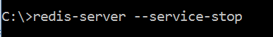
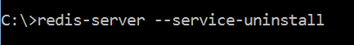
Install Redis As a Service

Slide 32
Libraries And Tools
Redis Desktop Manager
It’s like SSMS for Redis (sort of)
http://redisdesktop.com/

Slide 33
Libraries And Tools
StackExchange.Redis
Via NuGet
Available on Github
https://github.com/StackExchange/StackExchange.Redis

Slide 34
Libraries And Tools
JSON.NET
Via NuGet
Using this as a string serializer

Slide 35
Libraries And Tools
Microsoft.Web.RedisSessionStateProvider
Via NuGet
Using this as a string serializer

Slide 36
Libraries And Tools
Microsoft.Web.RedisSessionStateProvider
Via NuGet
Allows for the use of SessionState

Slide 37
Libraries And Tools
RedisRepo
Via NuGet - Beta
On Github:
https://github.com/Nebbia/RedisRepo

Slide 38
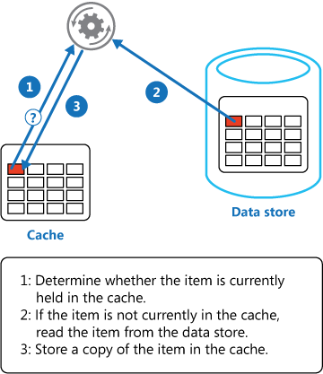
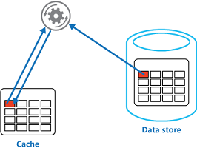
Cache Aside Pattern
Data Request

Slide 39

DEMO

Slide 40
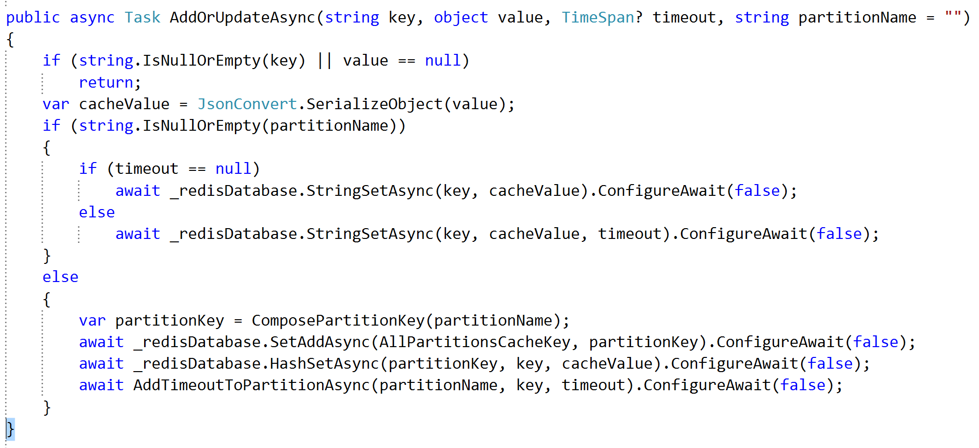

Slide 41
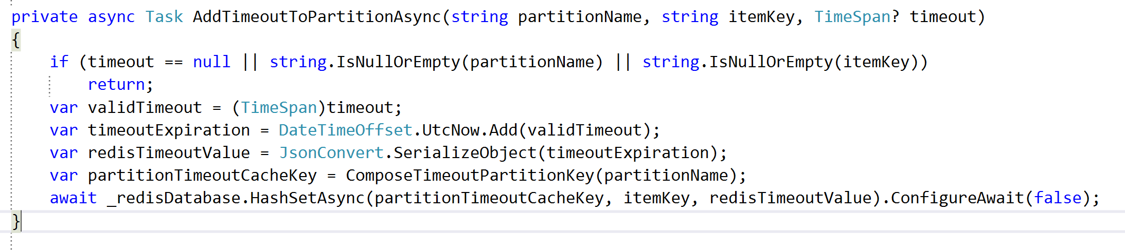

Slide 42
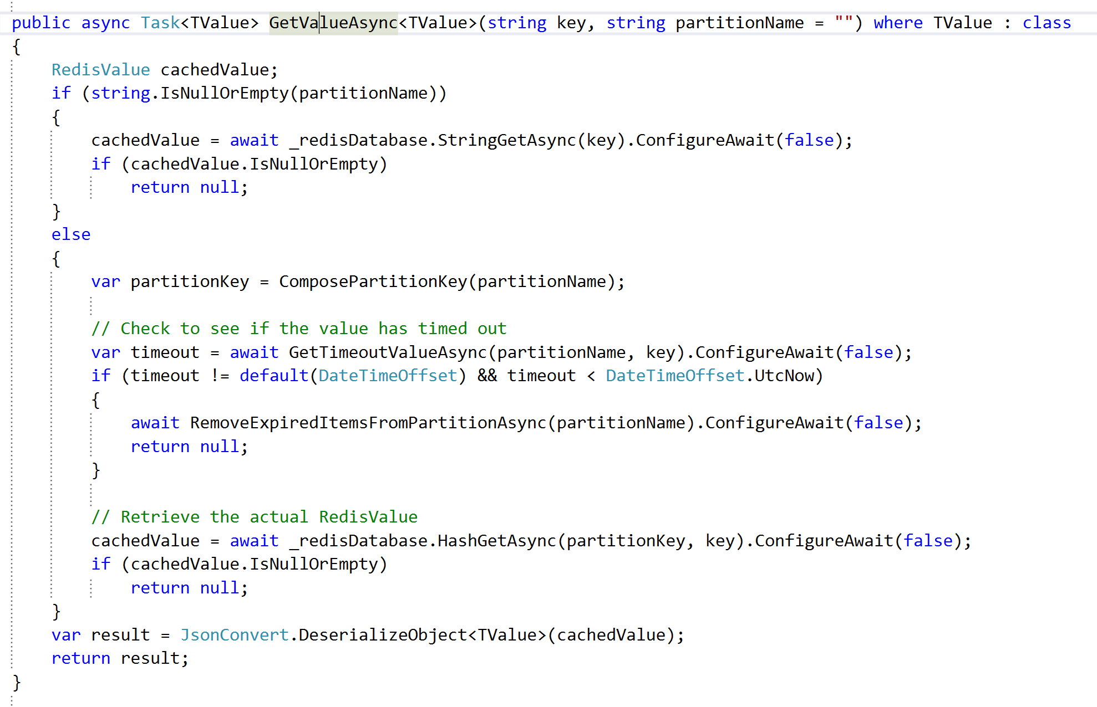

Slide 43
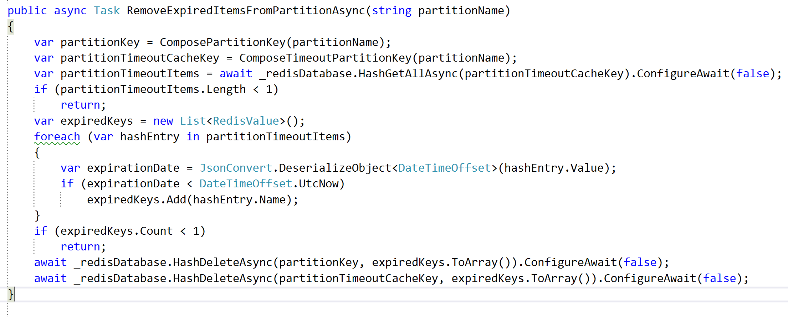

Slide 45
Questions?

Slide 46
Contact Info
Twitter: @Hallmanac
Github: https://github.com/hallmanac
Github: https://github.com/Nebbia/RedisRepo
Github: https://github.com/Hallmanac/redis-aspnet-azure
Email: Brian@NebbiaTech.com

